Slide 1
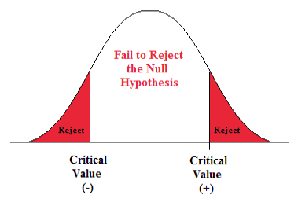
Inferential Statistics
This Photo by Unknown Author is licensed under CC BY-SA-NC
Lecture 7
Hypothesis Testing with Two Samples
Notes:
If this PowerPoint presentation contains mathematical equations, you may need to check that your computer has the following installed:
1) MathType Plugin
2) Math Player (free versions available)
3) NVDA Reader (free versions available)

Slide 2
Chapter Outline
7.1 Testing the Difference Between Means (Independent
Samples,
Known)
7.2 Testing the Difference Between Means (Independent
Samples,
Unknown)
7.3 Testing the Difference Between Means (Dependent Samples)
7.4 Testing the Difference Between Proportions

Slide 3
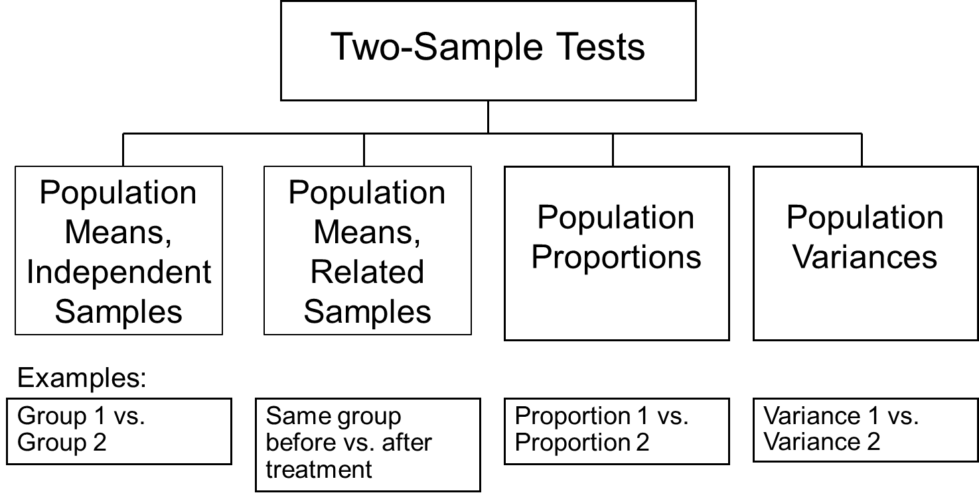
Two-Sample Tests
D C O V A

Slide 4
Section 7.1 Testing the Difference Between Means (Independent Samples, Sigma 1 and Sigma 2 Known)

Slide 5
Section 7.1 Objectives
How to determine whether two samples are independent or dependent
An introduction to two-sample hypothesis testing for the difference between two population parameters
Perform a two-sample z-test for the difference between
two means
using independent samples with
known

Slide 6
Two Sample Hypothesis Test
Compares two parameters from two populations.
Sampling methods:
Independent Samples
The sample selected from one population is not related to the sample selected from the second population.
Dependent Samples (paired or matched samples)
Each member of one sample corresponds to a member of the other sample.

Slide 7
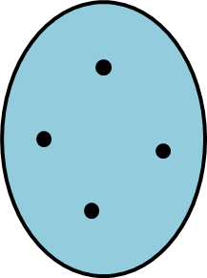
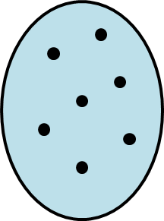
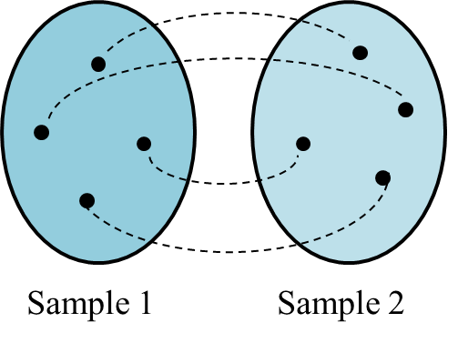
Independent and Dependent Samples
Independent Samples
Dependent Samples
Sample 1
Sample 2

Slide 8
Example: Independent and Dependent Samples (1 of 2)
Classify each pair of samples as independent or dependent.
Sample 1: Triglyceride levels of 70 patients Sample 2: Triglyceride levels of the same 70 patients after using a triglyceride-lowering drug for 6 months.
Solution:
These samples are dependent. Because the triglyceride levels of the same patients are taken, the samples are related. The samples can be paired with respect to each patient.

Slide 9
Example: Independent and Dependent Samples (2 of 2)
Classify each pair of samples as independent or dependent.
Sample 1: Scores for 38 adult males on a psychological screening test for attention-deficit/hyperactivity disorder Sample 2: Scores for 50 adult females on a psychological screening test for attention-deficit/hyperactivity disorder
Solution:
These samples are independent. It is not possible to form a pairing between the members of samples, the sample sizes are different, and the data represent scores for different individuals.

Slide 10
Two Sample Hypothesis Test With Independent Samples (1 of 2)
Null hypothesis
A statistical hypothesis that usually states there is no difference between the parameters of two populations.
Always contains the symbol
Alternative hypothesis
A statistical hypothesis that is true when
is false.
Always contains the symbol

Slide 11
Two Sample Hypothesis Test With Independent Samples (2 of 2)
Regardless of which hypotheses you use, you always assume there is no difference between the population
means, or

Slide 12
Two Sample z-Test for the Difference Between Means (1 of 4)
To perform a z-test for the difference between two
population means
when the samples are
independent, the following conditions are necessary.
The population standard deviations are known.
The samples are randomly selected.
The samples are independent.
The populations are normally distributed or each sample size is at least 30.

Slide 13
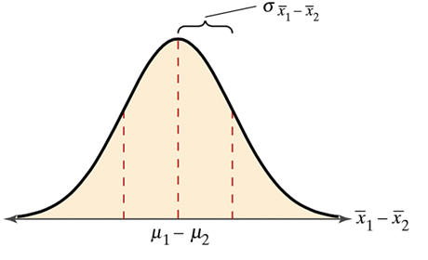
Two Sample z-Test for the Difference Between Means (2 of 4)
When these conditions are met, the sampling
distribution for
the difference of the sample
means, is a normal distribution with mean and standard error as shown.
Sampling Distribution for
Notes:
The bell curve is divided into 4 parts by 3 dotted vertical lines. One central line passes through the peak of the bell curve while the other two lines are left and right of the center line. The central line is mu subscript 1 minus mu subscript 2. The portion between the center line and the right line is denoted as sigma subscript x bar subscript 1 minus x bar subscript 2 end subscript.

Slide 14
Two Sample z-Test for the Difference Between Means (3 of 4)
In Words | In Symbols
The mean of the difference of the sample means is the assumed difference between the two population means. When no difference is assumed, the mean is 0. The variance of the sampling distribution is the sum of the variances of the individual sampling distributions for x sub 1 bar and x sub 2 bar. The standard error is the square root of the sum of the variances. | Mean = mu sub start expression x sub 1 bar minus x sub 2 bar end expression. Mean = mu sub start expression x sub 1 bar minus x sub 2 bar end expression. Equals mu sub x sub 1 bar minus mu sub x sub 2 bar. Equals mu sub 1 minus mu sub 2. Standard error = sigma sub start expression x sub 1 bar minus x sub 2 bar end expression. Equals square root of start expression sigma start fraction 2 over x sub 1 bar end fraction + sigma start fraction 2 over x sub 2 bar end fraction end expression. Equals square root of start expression start fraction sigma sub 1 squared over n sub 1 end fraction + start fraction sigma sub 2 squared over n sub 2 end fraction end expression.

Slide 15
Two Sample z-Test for the Difference Between Means (4 of 4)
A two-sample z-test can be used to test the difference between
two population means
when these conditions are met.
Both
are known.
The samples are random.
The samples are independent.
The populations are normally distributed or both
The test statistic is
The standardized test statistic is

Slide 16
Using a Two-Sample z-Test for the Difference Between Means (Independent Samples, Sigma Subscript 1 and Sigma Subscript 2 Known) (1 of 3)
In Words | In Symbols
1. Verify that sigma sub 1 and sigma sub 2 are known, the samples are random and independent, and either the populations are normally distributed or both n sub 1 greater than or equal to 30 and n sub 2 greater than or equal to 30. | Blank
2. State the claim mathematically and verbally. Identify the null and alternative hypotheses. | State H sub 0 and H sub a.

Slide 17
Using a Two-Sample z-Test for the Difference Between Means (Independent Samples, Sigma Subscript 1 and Sigma Subscript 2 Known) (2 of 3)
In Words | In Symbols
3. Specify the level of significance. | Identify alpha.
4. Determine the critical value(s). | Use Table 4 in Appendix B.
5. Determine the rejection region(s). | Blank
6. Find the standardized test statistic and sketch the sampling distribution. | z = start fraction left parenthesis x sub 1 bar minus x sub 2 bar right parenthesis minus left parenthesis mu sub 1 minus mu sub 2 right parenthesis over sigma sub start expression x sub 1 bar minus x sub 2 bar end expression.

Slide 18
Using a Two-Sample z-Test for the Difference Between Means (Independent Samples, Sigma Subscript 1 and Sigma Subscript 2 Known) (3 of 3)
In Words | In Symbols
7. Make a decision to reject or fail to reject the null hypothesis. | If z is in the rejection region, reject H sub 0. Otherwise, fail to reject H sub 0.
8. Interpret the decision in the context of the original claim. | Blank

Slide 19
Example: Two-Sample z-Test for the Difference Between Means
A credit card watchdog group claims that there is a difference in the mean credit card debts of people in Oklahoma and North Carolina. The results of a random survey of 250 people from each state are shown at the left. The two samples are independent.
Assume that
for California and
for Florida. Do the results support the group’s claim? Use
(Adapted from Experian)
Oklahoma | North Carolina
x sub 1 bar = $5271. | x sub 2 bar = $5121.
n sub 1 = 250. | n sub 2 = 250.

Slide 20
Solution: Two-Sample z-Test for the Difference Between Means (1 of 3)
Solution:
are known, the samples are random and independent,
and both
are at least 30. So, you can use the z-test.
The claim is “there is a difference in the mean credit card debts of people in Oklahoma and North Carolina.” So, the null and alternative hypotheses are
Because the test is a two-tailed test and the level of significance is
the critical values are
The rejection regions are

Slide 21
Solution: Two-Sample z-Test for the Difference Between Means (2 of 3)
The standardized test statistic is
Assume

Slide 22
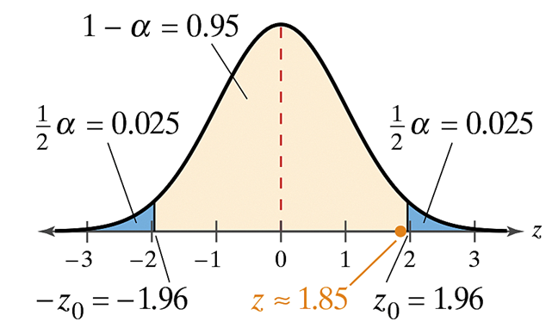
Solution: Two-Sample z-Test for the Difference Between Means (3 of 3)
The figure shows the location of the rejection regions and the standardized test statistic z. Because z is not in the rejection region, you fail to reject the null hypothesis.
There is not enough evidence at the 5% level of significance to support the group’s claim that there is a difference in the mean credit card debts of people in Oklahoma and North Carolina.
Notes:
Minus z subscript 0 equals minus 1.96 is near the left tail region and z subscript 0 equals 1.96 is near the right tail. The area under the curve to the left of minus z subscript 0 is given by fraction numerator 1 divided by denominator 2 end fraction alpha equals 0.025. The area under the curve to the right of z subscript 0 is given by fraction numerator 1 divided by denominator 2 end fraction alpha equals 0.025. The area under the curve between minus z subscript 0 and z subscript 0 is given by 1 minus alpha equals 0.95 with z approximately equals to 1.85 lying in this region.

Slide 23
Example 2: Perform a Two-Sample z-Test
A rental market researcher claims that the average monthly rent for a one‑bedroom apartment in Seattle, W A, is less than the average monthly rent for a one-bedroom apartment in Washington, D C. The table at the left shows the results of a random survey of people who rent apartments
in each city. The two samples are independent. Assume that
for Seattle and
for Washington, and that both populations are
normally distributed. At
is there enough evidence to support
the claim? (Adapted from RentPath Holdings, Inc.)
Seattle, W A | Washington, D C
x sub 1 bar = $2166. | x sub 2 bar = $2181.
n sub 1 = 400. | n sub 2 = 300.

Slide 24
Solution: Using Technology to Perform a Two-Sample z-Test (1 of 3)
Solution:
are known, the samples are random and
independent, and the populations are normally distributed. So, you can use the z-test. The claim is “the average monthly rent for a one-bedroom apartment in Seattle, W A, is less than the average monthly rent for a one-bedroom apartment in Washington, D C.” So, the null and alternative
hypotheses are
(claim).

Slide 25
Solution: Using Technology to Perform a Two-Sample z-Test (3 of 3)
Because the test is a left-tailed test and
the rejection region is
The standardized test
statistic
is not in the rejection region, so you
fail to reject the null hypothesis.
There is not enough evidence at the 1% level of significance to support the rental market researcher’s claim.

Slide 26
Chapter Outline
7.1 Testing the Difference Between Means (Independent
Samples,
Known)
7.2 Testing the Difference Between Means (Independent
Samples,
Unknown)
7.3 Testing the Difference Between Means (Dependent Samples)
7.4 Testing the Difference Between Proportions

Slide 27
Section 7.2 Objectives
How to perform a two-sample t-test for the difference
between two means
using independent samples
with
unknown

Slide 28
Two Sample t-Test for the Difference Between Means (1 of 4)
A two-sample t-test is used to test the difference between
two population means
when
are unknown,
the samples are random,
the samples are independent, and
the populations are normally distributed or both

Slide 29
Two Sample t-Test for the Difference Between Means (2 of 4)
The test statistic is
The standardized test statistic is s

Slide 30
Two Sample t-Test for the Difference Between Means (3 of 4)
Variances are equal: If the population variances are equal, then information from the two samples is combined to calculate a pooled estimate of the
standard deviation
The standard error for the sampling distribution of

Slide 31
Two Sample t-Test for the Difference Between Means (4 of 4)
Variances are not equal: If the population variances are not equal, then the standard error is

Slide 32
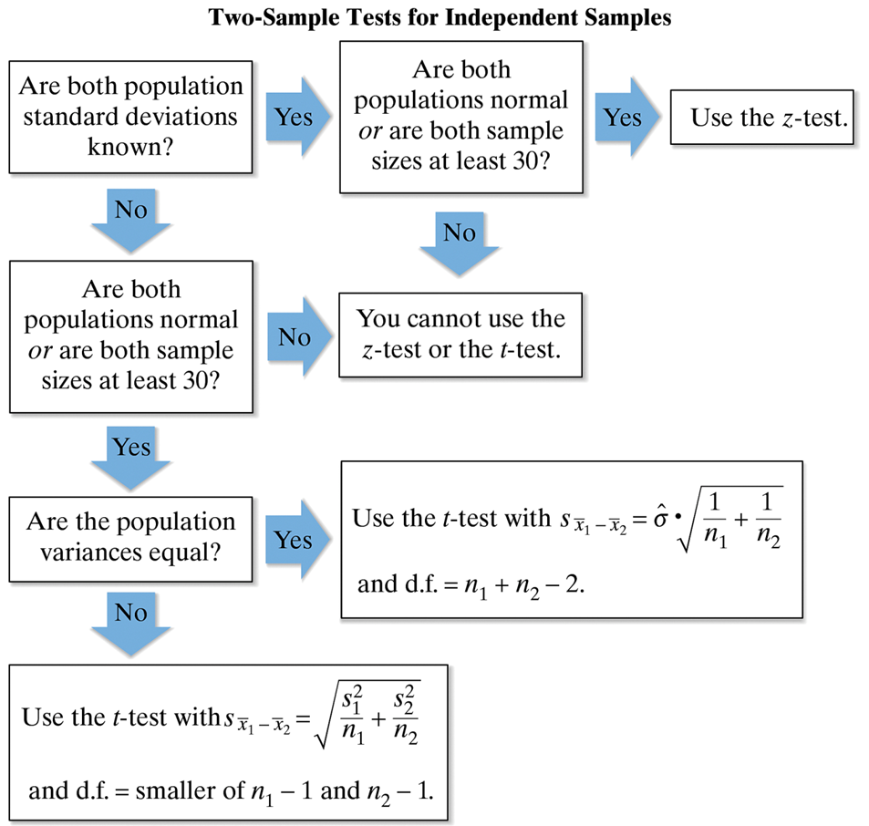
Two-Sample Tests for Independent Samples
Notes:
When "Are both population standard deviations known? is No, then, "Are both populations normal or are both sample sizes at least 30?" is Yes then "Are the populations variances equal?". If this is No, then "Use the t ­ test with s subscript x bar subscript 1 minus x bar subscript 2 end subscript. If, "Are both populations normal or are both sample sizes at least 30?" and "Are both populations normal or are both sample sizes at least 30?" then the output is "You cannot use the z ­ test or the t ­ test. If the, Are the populations variances equal?" is Yes then "Use the t-test with s subscript x bar subscript 1 end subscript minus x bar subscript 2 end subscript equals sigma hat times square root of fraction numerator 1 divided by denominator n subscript 1 end fraction plus fraction numerator 1 divided by denominator n subscript 2 end fraction end root and d.f. equals n subscript 1 plus n subscript 2 minus 2" and if "Are the population variances equal?" is No then the output is "Use the t­test with s subscript x bar subscript 1 minus x bar subscript 2 equals square root of fraction numerator s subscript 1 squared divided by denominator n subscript 1 end fraction plus fraction numerator s subscript 2 squared divided by denominator n subscript 2 end fraction and d.f. equals smaller of n subscript 1 minus 1 and n subscript 2 minus 1".

Slide 33
Two-Sample t-Test for the Difference Between Means (Independent Samples Sigma Subscript 2 and Sigma Subscript 2 Unknown) (1 of 3)
In Words | In Symbols
1. Verify that siSigma sub 1 and sigma sub 2. are known, the samples are random and independent, and either the populations are normally distributed or both n sub 1 greater than or equal to 30. and n sub 2 greater than or equal to 30. | Blank
2. State the claim mathematically and verbally. Identify the null and alternative hypotheses. | State H sub 0 and H sub a.
3. Specify the level of significance. | Identify alpha.

Slide 34
Two-Sample t-Test for the Difference Between Means (Independent Samples Sigma Subscript 2 and Sigma Subscript 2 Unknown) (2 of 3)
In Words | In Symbols
4. Determine the degrees of freedom. | d.f. = n sub 1 + n sub 2 minus 2 or d.f. = smaller of n sub 1 minus 1 or n sub 2 minus 1.
5. Determine the critical value(s). | Use Table 5 in Appendix B.
6. Determine the rejection region(s). | Blank

Slide 35
Two-Sample t-Test for the Difference Between Means (Independent Samples Sigma Subscript 2 and Sigma Subscript 2 Unknown) (3 of 3)
In Words | In Symbols
7. Find the standardized test statistic and sketch the sampling distribution. | t = start fraction left parenthesis x sub 1 bar minus x sub 2 bar right parenthesis minus left parenthesis mu sub 1 minus mu sub 2 right parenthesis over S sub start expression x sub 1 bar minus x sub 2 bar end expression end fraction.
8. Make a decision to reject or fail to reject the null hypothesis. | If t is in the rejection region, reject H sub 0. Otherwise, fail to reject H sub 0.
9. Interpret the decision in the context of the original claim. | Blank

Slide 36
Example: Two-Sample t-Test for the Difference Between Means (1 of 2)
The results of a state mathematics test for random samples of students taught by two different teachers at the same school are shown below. Can you conclude that there is a difference in the mean mathematics test scores for the
students of the two teachers? Use
Assume the
populations are normally distributed and the population variances are not equal.
Teacher 1 | Teacher 2
x sub 1 bar = 473. | x sub 2 bar = 459.
s sub 1 = 39.7. | s sub 2 = 24.5.
n sub 1 = 8. | n sub 2 = 18.

Slide 37
Solution: Two-Sample t-Test for the Difference Between Means (1 of 9)
Solution:
Note that
are unknown, the samples are random
and independent, and the populations are normally distributed. So, you can use the t-test. The claim is “there is a difference in the mean mathematics test scores for the students of the two teachers.” So, the null and alternative hypotheses are
(Claim)

Slide 38
Solution: Two-Sample t-Test for the Difference Between Means (2 of 9)
Because the population variances are not equal and the
smaller sample size is 8, use
The test is
a two-tailed test with d.f. = 7 and
so the critical
values are
The rejection
regions are

Slide 39
Solution: Two-Sample t-Test for the Difference Between Means (3 of 9)
The standardized test statistic is
Use the t-test (variances are not equal).
Assume

Slide 40
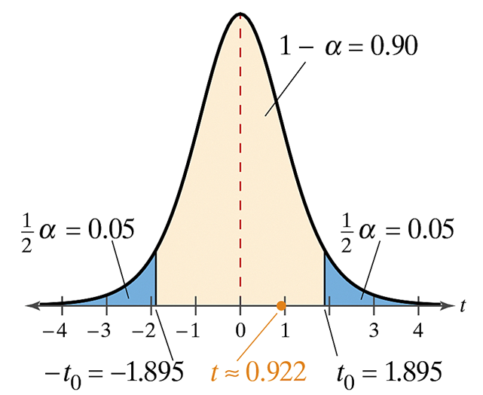
Solution: Two-Sample t-Test for the Difference Between Means (4 of 9)
The figure shows the location of the rejection regions and the standardized test statistic t. Because t is not in the rejection region, you fail to reject the null hypothesis.
There is not enough evidence at the 10% level of significance to support the claim that the mean mathematics test scores for the students of the two teachers are different.
Notes:
Minus t subscript 0 equals minus 1.895 is near the left tail region and t subscript 0 equals 1.895 is near the right tail region. The area under the curve to the left of minus t subscript 0 is given by fraction numerator 1 divided by denominator 2 end fraction alpha equals 0.05. The area under the curve to the right of t subscript 0 is given by fraction numerator 1 divided by denominator 2 end fraction alpha equals 0.05. The area under the curve between minus t subscript 0 and t subscript 0 is given by 1 minus alpha equals 0.90 with t approximately equals to 0.922 lying in this region.

Slide 41
Example: Two-Sample t-Test for the Difference Between Means (2 of 2)
An automobile manufacturer claims that the mean driving cost per mile of its sedans is less than that of its leading competitor. You conduct a study using 30 randomly selected sedans from the manufacturer and 32 from the
leading competitor. The results are shown. At
can you support the manufacturer’s claim? Assume the population variances are equal. (Adapted from American Automobile Association)
Manufacturer | Competitor
x sub 1 bar = $0.52 per mile. | x sub 2 bar = $0.55 per mile.
s sub 1 = $0.05 per mile. | s sub 2 = $0.07 per mile.
n sub 1 = 30. | n sub 2 = 32.

Slide 42
Solution: Two-Sample t-Test for the Difference Between Means (5 of 9)
Solution:
are unknown, the samples are random and
independent, and both
are at least 30. So, you
can use the t-test. The claim is “the mean driving cost per mile of the manufacturer’s sedans is less than that of its leading competitor.” So, the null and alternative hypotheses are
(Claim)

Slide 43
Solution: Two-Sample t-Test for the Difference Between Means (6 of 9)
The population variances are equal, so
Because the test is a left-tailed test
with d.f. = 60 and
the critical value is
The rejection region is

Slide 44
Solution: Two-Sample t-Test for the Difference Between Means (7 of 9)
To make the calculation of the standardized test statistic easier, first find the standard error.

Slide 45
Solution: Two-Sample t-Test for the Difference Between Means (8 of 9)
The standardized test statistic is
Use the t-test (variances are equal).
Assume

Slide 46
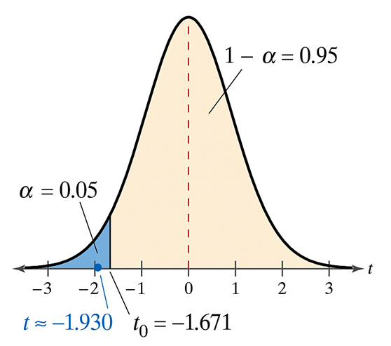
Solution: Two-Sample t-Test for the Difference Between Means (9 of 9)
The figure shows the location of the rejection region and the standardized test statistic t. Because t is in the rejection region, you reject the null hypothesis.
There is enough evidence at the 5% level of significance to support the manufacturer’s claim that the mean driving cost per mile of its sedans is less than that of its competitor’s.
Notes:
t subscript 0 equals minus 1.930 is near the left tail region. The area under the curve to the left of t subscript 0 is given by alpha equals 0.05 and is the rejection region. The area under the curve to the right of t subscript 0 is given by 1 minus alpha equals 0.95. t approximately equals to minus 1.671 lies to the left of t subscript 0.

Slide 47
Section 7.3 Testing the Difference Between Means (Dependent Samples)

Slide 48
t-Test for the Difference Between Means (1 of 4)
To perform a two-sample hypothesis test with dependent samples, the difference between each data pair is first found:
Difference between entries for a data pair
The test statistic is the mean
of these differences.
Mean of the differences between paired data entries in the dependent samples

Slide 49
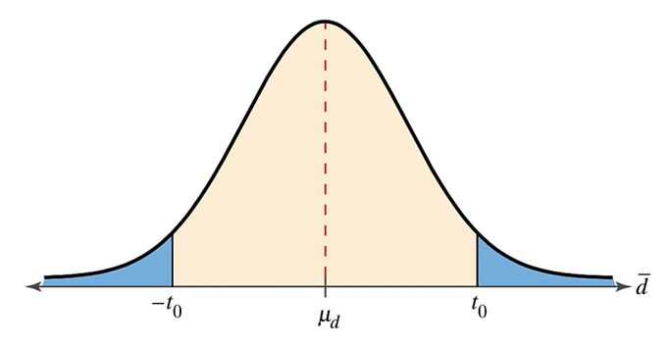
t-Test for the Difference Between Means (2 of 4)
Three conditions are required to conduct the test.
The samples must be randomly selected.
The samples must be dependent (paired).
Both populations must be normally distributed or the number n of pairs of data is at least 30.
If these conditions are met, then the sampling distribution for
the mean of the differences of the paired data entries in the dependent samples, is approximated by a t-distribution with
degrees of freedom, where n
is the number of data pairs.
Notes:
A vertical dotted line passes through the center of the bell curve (peak of the curve) and is denoted as mu subscript d. The left tail of the bell curve is shaded and is denoted as minus t subscript 0 whereas the right end of the bell curve is shaded and denoted as t subscript 0.

Slide 50
Symbols used for the t-Test for mu Subscript d (1 of 2)
Symbol | Description
n | The number of pairs of data
d | The difference between entries for a data pair, d = x sub 1 minus x sub 2.
mu sub d. | The hypothesized mean of the differences of paired data in the population

Slide 51
Symbols used for the t-Test for mu Subscript d (2 of 2)
Symbol | Description
d bar. | The mean of the differences between the paired data entries in the dependent samples d bar = start fraction summation of d over n end fraction.
S sub d. | The standard deviation of the differences between the paired data entries in the dependent samples S sub d = square root of start expression start fraction summation of left parenthesis d minus d bar right parenthesis squared over n minus 1 end fraction end expression.

Slide 52
t-Test for the Difference Between Means (3 of 4)
A t-test can be used to test the difference of two population means when these conditions are met.
The samples are random.
The samples are dependent (paired).
The populations are normally distributed or the number

Slide 53
t-Test for the Difference Between Means (4 of 4)
The test statistic is
The standardized test statistic is
The degrees of freedom are

Slide 54
t-Test for the Difference Between Means (Dependent Samples) (1 of 3)
In Words | In Symbols
1. Verify that the samples are random and dependent, and either the populations are normally distributed or n greater than or equal to 30. | Blank
2. State the claim mathematically and verbally. Identify the null and alternative hypotheses. | State H sub 0 and H sub a.
3. Specify the level of significance. | Identify alpha

Slide 55
t-Test for the Difference Between Means (Dependent Samples) (2 of 3)
In Words | In Symbols
4. Identify the degrees of freedom. | d.f. = n minus 1.
5. Determine the critical value(s). | Use Table 5 in Appendix B.
6. Determine the rejection region(s). | d bar = start fraction summation of d over n end fraction.
7. Calculate d bar and S sub d. | S sub d = square root of start expression start fraction summation of left parenthesis d minus d bar right parenthesis squared over n minus 1 end fraction end expression.

Slide 56
t-Test for the Difference Between Means (Dependent Samples) (3 of 3)
In Words | In Symbols
8. Find the standardized test statistic and sketch the sampling distribution. | t = start fraction d bar minus mu sub d over start fraction S sub d over square root of n end fraction end fraction.
9. Make a decision to reject or fail to reject the null hypothesis. | If t is in the rejection region, then reject H sub 0.o Otherwise, fail to reject H sub 0.
10. Interpret the decision in the context of the original claim. | Blank

Slide 57
Example: t-Test for the Difference Between Means (1 of 3)
A golf instruction and club fitting company claims that people who play golf can improve (decrease) their average golf scores by taking lessons from one of their coaches. The average golf scores of eight randomly selected people who play golf are determined before and after taking lessons from one of the company’s coaches. The results are shown in the
table. At
is there enough evidence to support the company’s claim?
Assuming the average golf scores are normally distributed
Person | 1 | 2 | 3 | 4 | 5 | 6 | 7 | 8
Average golf score (before lessons) | 96 | 95 | 95 | 99 | 87 | 104 | 105 | 94
Average golf score (after lessons) | 89 | 90 | 95 | 94 | 91 | 100 | 103 | 100

Slide 58
Solution: Two-Sample t-Test for the Difference Between Means (1 of 5)
Solution:
Because the samples are random and dependent, and the populations are normally distributed, you can use the t-test. The claim is that “people who play golf can improve (decrease) their average golf scores.” In other words, the company claims that a person’s average golf score before taking the lessons will be greater than the person’s average golf score after taking the lessons. Each difference is given by
The null and alternative hypotheses are
(Claim)

Slide 59
Solution: Two-Sample t-Test for the Difference Between Means (2 of 5)
Because the test is a right-tailed test,
and
the critical value is
The rejection
region is t > 1.415. Using the table on the next slide, you
can calculate
as shown on the next slide. Notice
that the alternate formula is used to calculate the standard deviation.

Slide 60
Solution: Two-Sample t-Test for the Difference Between Means (3 of 5)
Before | After | d | d squared.
96 | 89 | 7 | 49
95 | 90 | 5 | 25
95 | 95 | 0 | 0
99 | 94 | 5 | 25
87 | 91 | Negative 4. | 16
104 | 100 | 4 | 16
105 | 103 | 2 | 4
94 | 100 | Negative 6. | 36
Blank | Blank | Summation = 13. | Summation = 171.

Slide 61
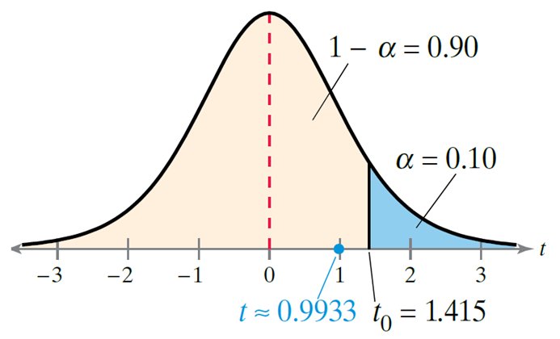
Solution: Two-Sample t-Test for the Difference Between Means (4 of 5)
The standardized test statistic is
The figure shows the location of the rejection region and the standardized test statistic t. Because t is not in the rejection region, you fail to reject the null hypothesis.
Notes:
The mean is marked at 0. The region to the left of t 0 = 1.415 is shaded pink and it is labeled 1 minus alpha = 0.90. The region to the right of t 0 = 1.415 is shaded blue and it is labeled alpha = 0.10. Point t approximately equal to 0.9933 is marked.

Slide 62
Solution: Two-Sample t-Test for the Difference Between Means (5 of 5)
There is not enough evidence at the 10% level of significance to support the golf instruction and club fitting company’s claim that people who play golf can improve (decrease) their average golf scores by taking lessons from one of their coaches.

Slide 63
Example: t-Test for the Difference Between Means (2 of 3)
The campaign staff for a state legislator wants to determine whether the legislator’s performance rating (0 –100) has changed from last year to this year. The table below shows the legislator’s performance ratings from the same 16 randomly selected voters for last year and this year. At
is there enough evidence to conclude that the
legislator’s performance rating has changed? Assume the performance ratings are normally distributed.

Slide 64
Example: t-Test for the Difference Between Means (3 of 3)
Voter | 1 | 2 | 3 | 4 | 5 | 6 | 7 | 8
Rating (last year) | 60 | 54 | 78 | 84 | 91 | 25 | 50 | 65
Rating (this year) | 54 | 46 | 68 | 58 | 83 | 38 | 38 | 53
Voter | 9 | 10 | 11 | 12 | 13 | 14 | 15 | 16
Rating (last year) | 68 | 81 | 75 | 45 | 62 | 79 | 58 | 63
Rating (this year) | 78 | 72 | 76 | 48 | 48 | 83 | 51 | 58

Slide 65
Solution: t-Test for the Difference Between Means (1 of 5)
Solution:
Because the samples are random and dependent, and the populations are normally distributed, you can use the t-test. If there is a change in the legislator’s rating, then there will be a difference between last year’s ratings and this year’s ratings. Because the legislator wants to determine whether there is a difference, the null and alternative hypotheses are
(Claim)

Slide 66
Solution: t-Test for the Difference Between Means (2 of 5)
Because the test is a two-tailed test,
and
the critical values are
The rejection regions are

Slide 67
Solution: t-Test for the Difference Between Means (3 of 5)
Before | After | d | d squared.
60 | 54 | 6 | 36
54 | 46 | 8 | 64
78 | 68 | 10 | 100
84 | 58 | 26 | 676
91 | 83 | 8 | 64
25 | 38 | negative 13 | 169
50 | 38 | 12 | 144
65 | 53 | 12 | 144
68 | 78 | negative 10 | 100
81 | 72 | 9 | 81
75 | 76 | negative 1 | 1
45 | 48 | negative 3 | 9
62 | 48 | 14 | 196
79 | 83 | Negative 4. | 16
58 | 51 | 7 | 49
63 | 58 | 5 | 25
Blank | Blank | summation = 86. | summation = 1874.

Slide 68
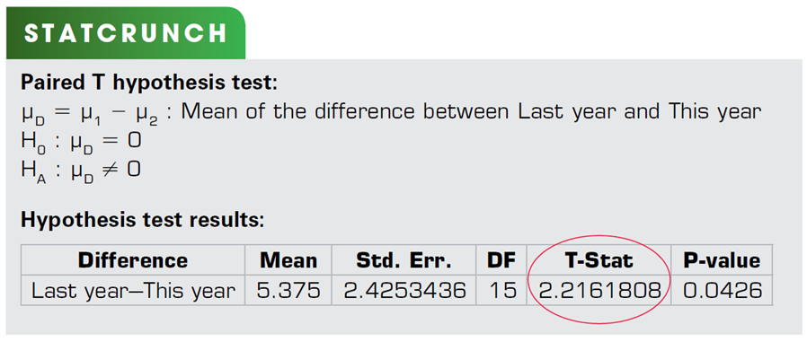
Solution: t-Test for the Difference Between Means (4 of 5)
The standardized test statistic is
Use the t-test.
Assume
You can check this result using technology
Notes:
The box is titled Statcrunch. The note above the table reads as follows. Paired T hypothesis test: mu sub 0 = mu sub 1 minus mu sub 2; mean of the difference between last year and this year. Mu sub 0 : mu sub 0 = 0. H sub A : mu sub 0 not equal to 0. Hypothesis test results. The table has 6 columns and one row. The data is as follows. Difference, last year to this year. Mean, 5.375. Standard error, 2.4253436. D F, 15. T-stat, 2.2161808. P-value, 0.0426. T-stat, 2.2161808 is highlighted.

Slide 69
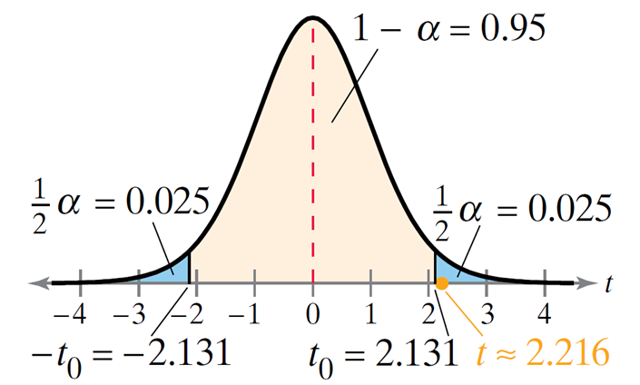
Solution: t-Test for the Difference Between Means (5 of 5)
The figure shows the location of the rejection region and the standardized test statistic t. Because t is in the rejection region, you reject the null hypothesis.
There is enough evidence at the 5% level of significance to conclude that the legislator’s performance rating has changed.
Notes:
The mean is marked at 0. The region to the left of negative t 0 = negative 2.131 is shaded blue and it is labeled half alpha = 0.025. The region to the right of t sub 0 = 2.131 is shaded blue and it is labeled half alpha = 0.025. The region in between negative t sub 0 = negative 2.131 and t sub 0 = 2.131 is shaded pink and it is labeled 1 minus alpha = 0.95. Point t approximately equal to 2.216 is marked.

Slide 70
Section 7.4 Testing the Difference Between Proportions

Slide 71
Section 7.4 Objectives
How to perform a two-sample z-test for the difference
between two population proportions

Slide 72
Two-Sample z-Test for Proportions
Used to test the difference between two population
proportions,
Three conditions are required to conduct the test.
The samples must be randomly selected.
The samples must be independent.
The samples must be large enough to use a normal
sampling distribution. That is,

Slide 73
Two-Sample z-Test for the Difference Between Proportions (1 of 5)
If these conditions are met, then the sampling distribution
for
is a normal distribution
Mean:
A weighted estimate of
can be found by using
Standard error:

Slide 74
Two-Sample z-Test for the Difference Between Proportions (2 of 5)
A two-sample z-test is used to test the difference between
two population proportions
when these
conditions are met.
The samples are random.
The samples are independent.
The quantities
are at least 5.
The test statistic is
The standardized test statistic is

Slide 75
Two-Sample z-Test for the Difference Between Proportions (3 of 5)
In Words | In Symbols
1. Verify that the samples are random and independent. | Blank
2. Find the weighted estimate of p sub 1 and p sub 2.. Verify that n sub 1 p bar, n sub 1 q bar, n sub 2 p bar, and n sub 2 q bar. are at least 5. | p bar = start fraction x sub 1 + x sub 2 over n sub 1 + n sub 2, q bar = 1 minus p bar.
3. State the claim mathematically and verbally. Identify the null and alternative hypotheses. | State H sub 0 and H sub a.
4. Specify the level of significance. | Identify alpha.

Slide 76
Two-Sample z-Test for the Difference Between Proportions (4 of 5)
In Words | In Symbols
5. Determine the critical value(s). | Use Table 4 in Appendix B.
6. Determine the rejection region(s). | Blank
7. Find the standardized test statistic and sketch the sampling distribution. | z = start fraction left parenthesis p sub 1 hat minus p sub 2 hat right parenthesis minus left parenthesis p sub 1 minus p sub 2 right parenthesis over square root of start expression p bar q bar left parenthesis start fraction 1 over n sub 1 end fraction + start fraction 1 over n sub 2 end fraction right parenthesis end expression end fraction.

Slide 77
Two-Sample z-Test for the Difference Between Proportions (5 of 5)
In Words | In Symbols
8. Make a decision to reject or fail to reject the null hypothesis. | If z is in the rejection region, reject H sub 0.Otherwise, fail to reject H sub 0.
9. Interpret the decision in the context of the original claim. | Blank

Slide 78
Example: Two-Sample z-Test for the Difference Between Proportions (1 of 2)
A study of 200 randomly selected people driving vehicles in Washington and 250 randomly selected people driving vehicles in Vermont shows that 93.0% of people driving vehicles in Washington and 88.8% of people
driving vehicles in Vermont wear seat belts while driving. At
can you reject the claim that the proportion of people who wear seat belts while driving is the same for Washington and Vermont? (Adapted from National Highway Traffic Safety Administration)
Sample Statistics for Seat Belt Use
Washington | Vermont
n sub 1 = 200. | n sub 2 = 250.
p sub 1 hat = 0.930. | p sub 2 hat = 0.888.
x sub 1 = 186. | x sub 2 = 222.

Slide 79
Solution: Two-Sample z-Test for the Difference Between Proportions (1 of 8)
Solution:
The samples are random and independent. Also, the weighted
estimate of
and the value of q is
Because
are at least 5, you can use a two-sample
z-test.

Slide 80
Solution: Two-Sample z-Test for the Difference Between Proportions (2 of 8)
The claim is “the proportion of people who wear seatbelts while driving is the same for Washington and Vermont.” So, the null and alternative hypotheses are
Because the test is two-tailed and the level of significance is
the critical values are
The rejection regions are

Slide 81
Solution: Two-Sample z-Test for the Difference Between Proportions (3 of 8)
The standardized test statistic is

Slide 82
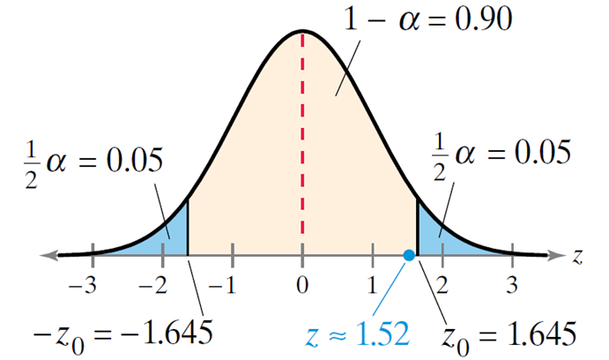
Solution: Two-Sample z-Test for the Difference Between Proportions (4 of 8)
The figure below shows the location of the rejection regions and the standardized test statistic z. Because z is not in the rejection region, you fail to reject the null hypothesis.
There is not enough evidence at the 10% level of significance to reject the claim that the proportion of people who wear seat belts while driving is the same for Washington and Vermont.
Notes:
The horizontal axis ranges from negative 3 to 3 in increments of 1. The region to the right of z sub 0 = 1.645 is shaded blue and the region to the left of negative z sub 0 = negative 1.645 are shaded blue and they are labeled half alpha = 0.05. The region in between negative 1.645 and 1.645 is shaded pink and labeled 1 minus alpha = 0.90. Point z approximately equal to 1.52 is marked.

Slide 83
Example: Two-Sample z-Test for the Difference Between Proportions (2 of 2)
A medical research team conducted a study to test the effect of a medication to treat patients with post-traumatic stress disorder (P T S D). At the end of the study, the researchers found that of the 42 randomly selected subjects who took the medication, 28 no longer met the diagnostic criteria for P T S D. Of the 37 randomly selected subjects who took a placebo, 12 no longer met the diagnostic criteria for P T S D. At
can you support the claim that the reduction rate in the
diagnostic criteria for P T S D is higher for those who took the medication than for those who took the placebo? (Adapted Nature Medicine)
Received medication | Received placebo
n sub 1 = 42. | n sub 2 = 37.
x sub 1 = 28. | x sub 2 = 12.
p sub 1 hat approximately equal to 0.6667. | p sub 2 hat approximately equal to 0.3243.

Slide 84
Solution: Two-Sample z-Test for the Difference Between Proportions (5 of 8)
Solution:
The samples are random and independent. Also, the weighted
estimate of
and the value of
Because
are at least 5, you can use a two-sample
z-test.

Slide 85
Solution: Two-Sample z-Test for the Difference Between Proportions (6 of 8)
The claim is “the reduction rate in the diagnostic criteria for P T S D is higher for those who took the medication than for those who took the placebo.” So, the null and alternative hypotheses are
Because the test is a right-tailed and the level of significance is
the critical values is
The rejection region is

Slide 86
Solution: Two-Sample z-Test for the Difference Between Proportions (7 of 8)
The standardized test statistic is

Slide 87
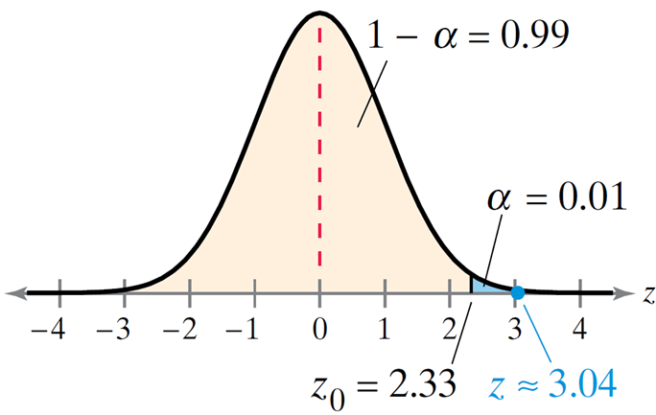
Solution: Two-Sample z-Test for the Difference Between Proportions (8 of 8)
The figure below shows the location of the rejection region and the standardized test statistic z. Because z is in the rejection region, you reject the null hypothesis.
There is enough evidence at the 1% level of significance to support the claim that the reduction rate in the diagnostic criteria for P T S D is higher for those who took the medication than for those who took the placebo.
Notes:
The horizontal axis ranges from negative 4 to 4 in increments of 1. The region to the right of z sub 0 = 2.33 is shaded blue and labeled alpha = 0.01. The region to the left of z sub 0 = 2.33 is shaded pink and labeled 1 minus alpha = 0.99. Point z approximately equal to 3.04 is marked.

